Slide 1
IDM Exercise 1

Slide 2
Case study: A Large, Resort-like hotel
Assignement:
build the IDM documentation (graphical and textual specifications, including pages sketches) of a web site for POLIRESORT - a (fictitious) 4 stars resort on the sea that offers a variety of services and structures

Slide 3
POLIRESORT: assumptions
The web side is intended to be used on stationary devices (labtops, desktops, kiosks)
End-users (Resort main Target Clients):
  Medium-high level people (including families) looking for a short period of relax and particularly interested in sport, wellness, good food, pleasant environment…
  Couples - to organize their weeding or family anniversaries)
  Companies – to organize large meetings, conventions, events
Main goals of the application
  from the perspective of the hotel management:
    Promotion: to promote the resort and its services (creating good reputation and trust in the resort)
    Information: to present all services and structures available, highlighting all to possibilities offered and pinpointing their variety and quality
  from the perspective of the end-users: to get all information needed to plan an event or a short holiday in the resort

Slide 4
POLIRESORT: MAIN CONTENTS
KIND OF TOPICS
Strutture - Structures (e.g., swimming pools, tennis courts, soccer court, volley court, meeting rooms, disco, reception rooms, wellness center, ….)
Servizi = Services (e.g., massage, beauty treatment, personal training, baby-sitting, children animation, tennis lessons, swimming lessons, bridge competitions, ….)
Eventi = Events taking place at the resort, month by month (e.g., weddings, conferences, meetings, “special” courses during weekend, “special” evenings, …)
Offerte = Special Offers (e.g., “anniversary weend”, “family week package”, “San Valentino Special”, “bridge week”, …)
Tipi di camera = Room Types (e.g., suite, junior suite, “romantic”, double-normal, double-extra large, four-bedrooms, …)
Ristoranti = Restaurants (e.g., on-the-wood, on-the-beach, terrace, …)
Menus offered by the different restaurants, or selected for different events
SINGLE TOPICS
Reception, Contacts, Where we are

Slide 5
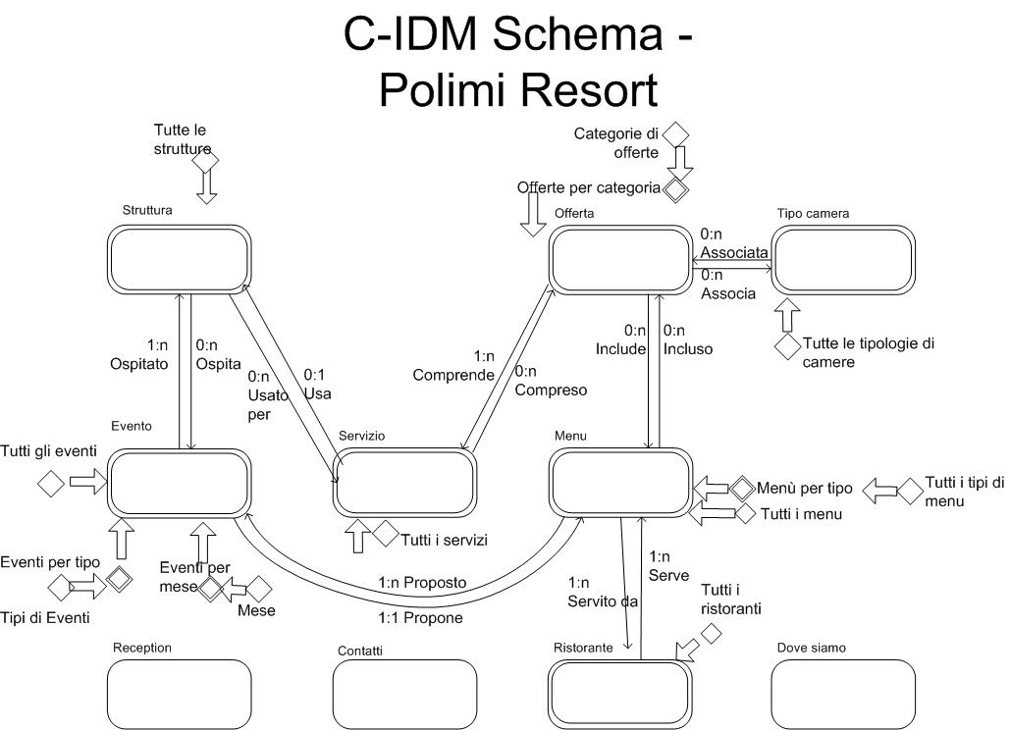

Slide 6
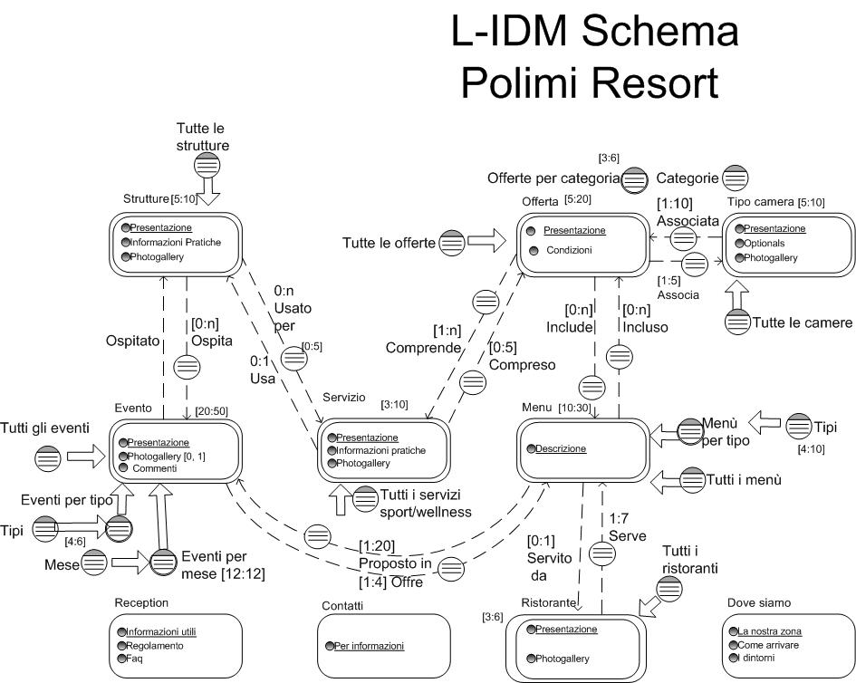

Slide 7
POLIMI Resort: P-IDM schema
Refreshing and detailing some notation…
Topic Page containing SEVERAL Content Dialogue acts for the same topic, or several Introductory Acts
Page name
Set of links (with pattern P): Double line or fat arrow
P
P
To put a Transition Act INSIDE a Topic Page or inside all Topic Pages for the same topic Group of Pages. The links for the Relevant relationship is put close to the symbol
Example:
R1
R2
R2
R1

Slide 8
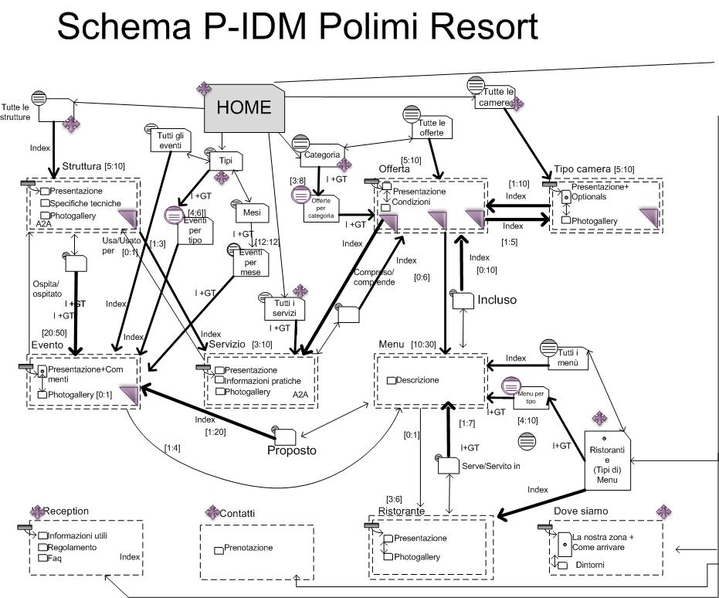

Slide 9
Some observations on P-IDM
Some links have beed creates that connect some top level introductory pages in order to improve accessibility and to reduce the number of landmarks e.g.
  between Types of Events page – landmark, and All Events
  between Types of Events page – landmark, and Months (from which to select events of a given month)
  between Categories of Offers – landmark, and All Offers
In three cases L-IDM dialogue acts have been merged, e.g.,
  “Tipo Camera” (Type of Room): Content Dialogue Acts Presentation and Optionals have been merged
  “Dove siamo” (Where we are): Content Dialogue Acts La nostra Zona (Our area) e Come arrivare (How to get here) have been merged
  Introductory Acts “All Restaurants” and Menu Types have been merged in a single page
Some transition acts have been embedded in all pages of a Topic which is the source of a relevant relationship, e.g. Event, Structure, and Offer
The simbol is omitted when the topic includes one page only

Slide 10
exercise
CREATE SOME IN THE SMALL SPECIFICATIONS FOR THE PAGES IN THE P-IDM SCHEMA
TOPIC/KIND OF TOPIC/ (MULTIPLE) GROUP NAME/ PAGE NAME
LANDMARKS
Landmark 1/label |  |  |  |  |  | Landmark N/Label
…
Structural/Semantic/Group Links
Structural/Semantic/Group Link 1/Label | Structural/Semantic/Group Link 1/Destination Preview (if needed) |  |  |  | Structural/Semantic/Group Link N/Label | Structural/Semantic/Group Link L/Destination Preview (if needed)
Main Content
Attribute 1 |  |  |  |  |  | Attribute M
Orientation Info

